Slide 1
“Live the Zealous Life”
Campaign for Our Community Place
Presented by
🍀Lucky LeapFrogs🐸

Slide 2
Campaign Goals: IMC Objectives
55% of the target market should be knowledgeable about the quality of Zealous Pesto by June 23, 2017
44% of the target market should like that Zealous offers a quality pesto made in the Valley by June 26, 2017
75% of the target market needs to be aware of Zealous Pesto by June 21, 2017
25% of the target market should prefer fresh pesto made with good quality oil, and not poor oil preservatives by June 28, 2017
12% of the target market should buy good quality pesto that is produced locally on the product launch date of July 1st, 2017
5% of the target market should feel inclined to spread news about Zealous’ fresh quality pesto July 15, 2017

Slide 3
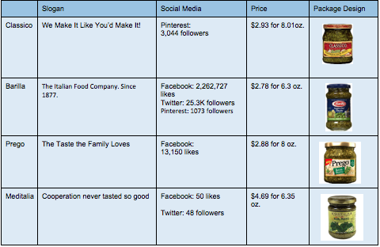
The Pesto Industry: Competitive Analysis
The Seasoning, Sauce, and Condiment Industry has a very low level of market share.
Brand loyalty plays a large role in the industry.
Disposable income has drastically grown over the past five years, allowing consumers to upgrade to gourmet and luxury products.
Price plays a large role in the perceived value of a product or brand.
higher price = higher value

Slide 4
Major Selling Idea:
Zealous brings luxury into even the simplest of meals. With the addition of our pesto, meals instantly transform into an elegant and classy social event, not just your average meal.
Slogan:
Live the Zealous Life

Slide 5
How to Sell Luxury? Proposed Recipe
& Product Packaging
We propose Zealous to have 25% more basil to enhance its richness and potency in order to increase perceived quality.
We suggest using a black label to portray luxury and exclusivity.
We recommend pricing Zealous at $4.29 to imply brand quality.

Slide 6
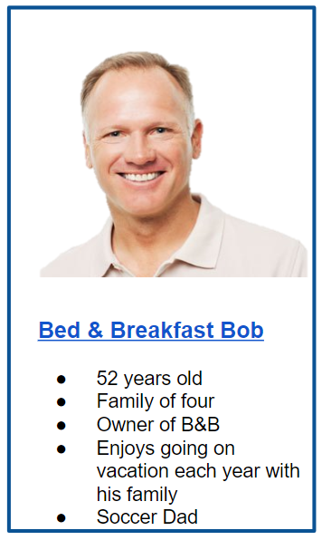
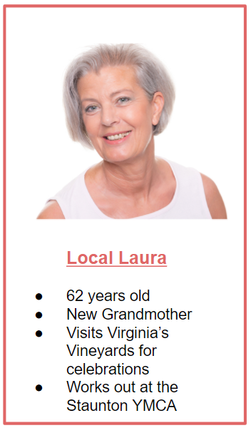
We propose two unique target markets to “Live the Zealous Life”
Primary Market: Bed & Breakfast Owners
Second Market: Valley Locals
B-2-B with a “twist”
We propose personal selling to 21 local bed and breakfast owners.
Of these, we believe 10 will accept our proposition.
Women living in the Valley
“Baby Boomers”
- 55-69 years of age
Homeowners
Upper-Middle Class
- 27,461 potential households with 43,358 potential consumers
- $60,000 - $125,000 *per household*

Slide 7
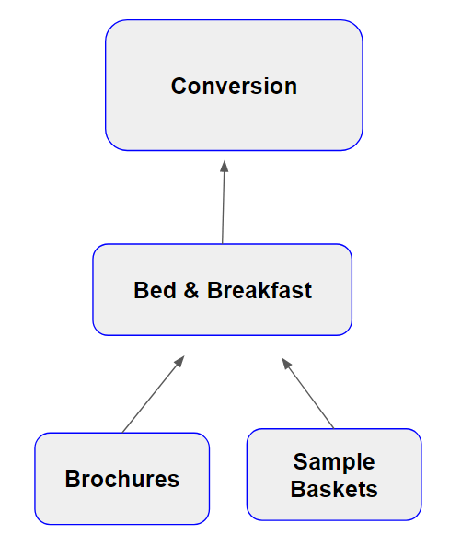
Target Market #1: Bed & Breakfast Owners
B&B Integration Map
Profitability of Market
Virginia ranks 9th in Domestic Traveler Spending
Shenandoah Valley accounted for nearly 10% of Virginia’s traveler spending in 2011
Tourism sector growing nearly 2.5% per year
Constant influx of travelers due to major nodes of transportation, (Route 11 and I-81) and historic activities and sites (Skyline Drive, Downtown Harrisonburg, etc.,)

Slide 8
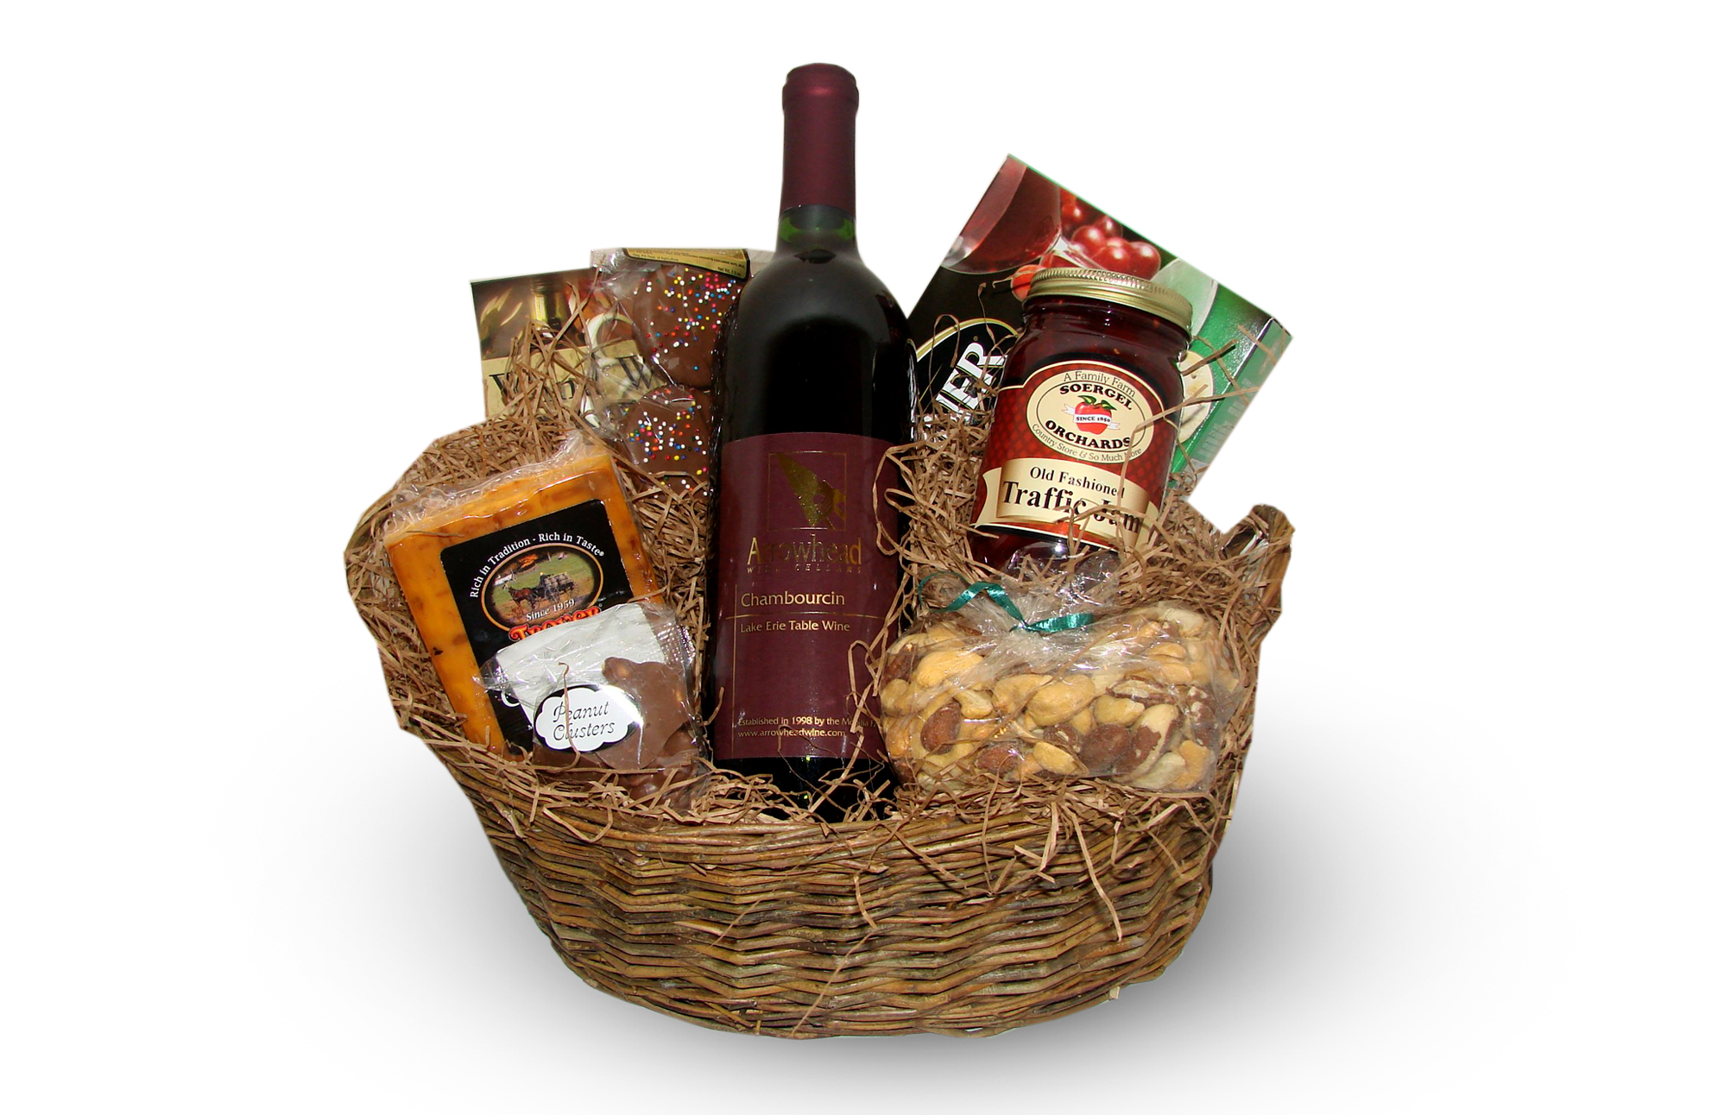
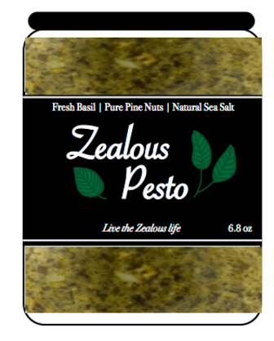
How to target Bed & Breakfast Bob?
What’s included?
“Taste the Valley” Sample Baskets
Through cooperation with other local retailers, these baskets will contain a variety of specialty goods produced in the four counties (Shenandoah, Page, Augusta, & Rockingham)
We propose the idea of selling these baskets to the 21 B&B owners over a fancy dinner.
We predict 10 owners will agree to provide “Taste the Valley” baskets and products to their guests available for purchase.
6.8 oz. jar of Zealous pesto
16 oz. of The Country Canner black raspberry jam
Beef Jerky from Stanley’s Meat Market
12 oz. of Hott Apirary raw honey
One bottle of Cross Keys’ Petit Verdot

Slide 9
11 ½” x 8” Trifold Brochure (within baskets)
Side A
Side B
What information is included?
The brochure provides information about the effort of Our Community Place as well as information about Zealous Pesto and local retailer providers. Brochures can be found in the sample baskets accompanying the pesto.

Slide 10
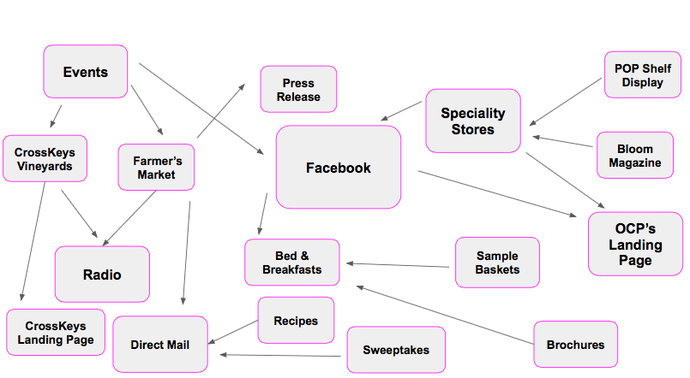
Target Market #2 - Local Laura
Purchasing Patterns of Babyboomers
93% value freshness very highly
53% response rate for Direct Mail pieces
46% hold on to magazines after reading
80% create lists before shopping
Price conscious, but willing to pay for quality products
Local Laura Integration Map
Local Involvement
Prefer specialty stores to retail chains
Generate 41% of wine sales
*(Virginia Wine Industry records over $1 billion in sales annually)

Slide 11
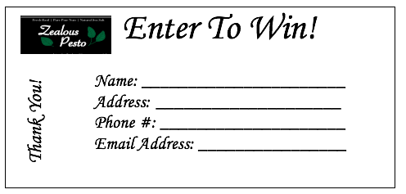
Local Laura LOVES going to the Farmers Market. Let’s meet her there!
Basket Sweepstakes
Sweepstakes should be hosted on July 8th and August 15th at Zealous Pesto’s booth.
Prize: “Taste the Valley” sample basket.
Entry form information will be collected for OCP to build a mailing database.
The winner should be randomly selected.
Product Sampling
We recommend providing samples at Harrisonburg’s Farmers Market every Tuesday and Saturday for two weeks beginning on July 1st
Booth will provide Zealous pesto along with saltine crackers
Mailing list sign-up sheets will be available at the booth as well.

Slide 12
Pre and Post Farmer’s Market Promotions
WMRA 30” Radio Ad (Script)
4” x 6” Follow up Postcard
We propose the following 30 second ad to air in all four counties reached by the WMRA radio station:
Frontside
The Harrisonburg Farmer’s Market will be taking place this Saturday between 8 and 1 PM at 288 South Liberty Street. Come out and enjoy all of the local vendors, including the Market’s newest vendor, Our Community Place and their new Zealous Pesto. For more information visit ourcommunityplace.com/zealouspesto.
A Message from Our Community Place.
Backside

Slide 13
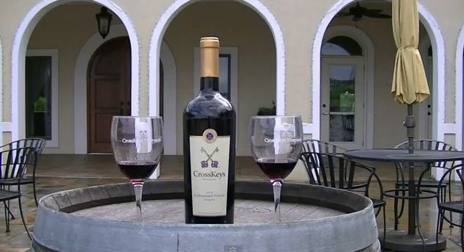
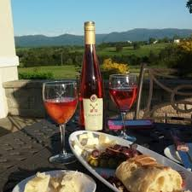
CrossKeys Vineyards
“Finally Friday’s” Featurette
Every Friday night CrossKeys hosts live music and wine tasting.
We recommend a partnership where Zealous Pesto will be served with bruschetta as the main hor d'oeuvre to accompany the visitors’ glasses of wine.
Visitors will be able to relax, enjoy the night, and “Live the Zealous Life.”
WMRA 30” Radio Ad (Script)
The Non Profit Our Community Place will be hosting a “Live the Zealous Life” pesto tasting at CrossKeys Vineyard. Try free samples of Zealous Pesto while you enjoy CrossKey’s wine. This event will be Friday from 5:30 to 8:30PM. Reserve your ticket at livethezealouslife.com.
A message from Our Community Place.

Slide 14
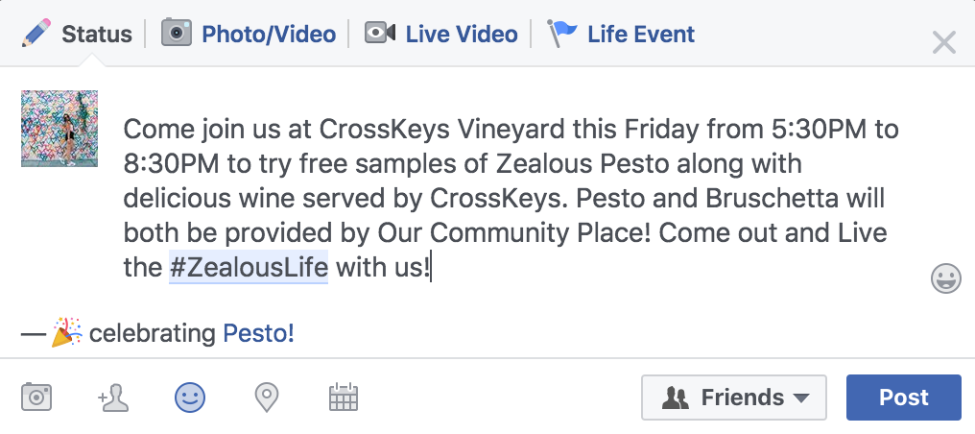
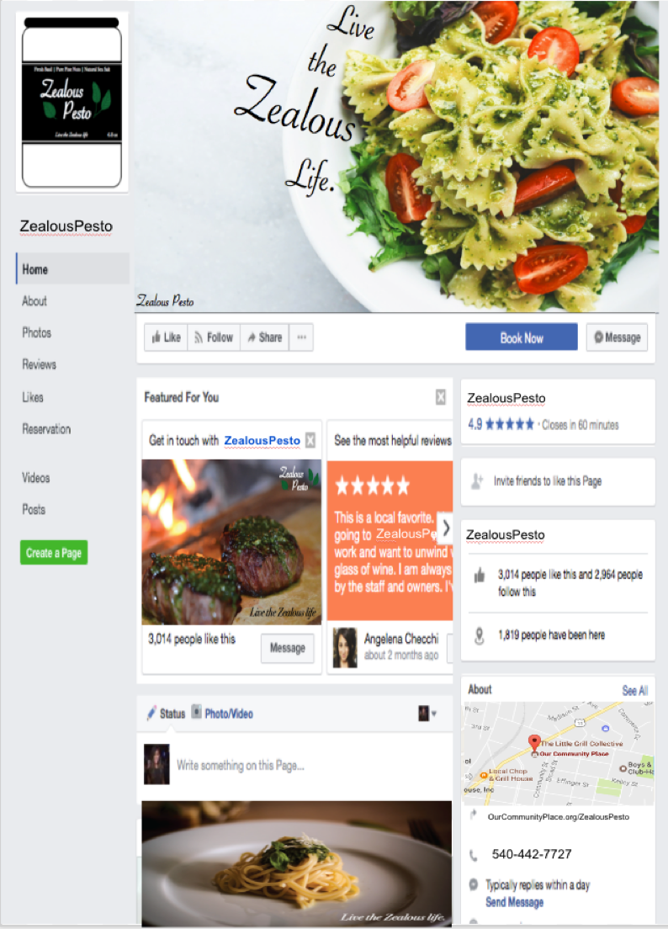
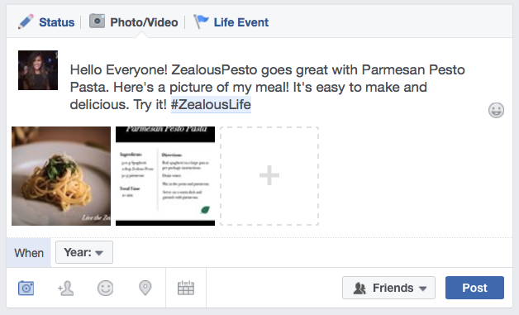
Facebook Page

Slide 15
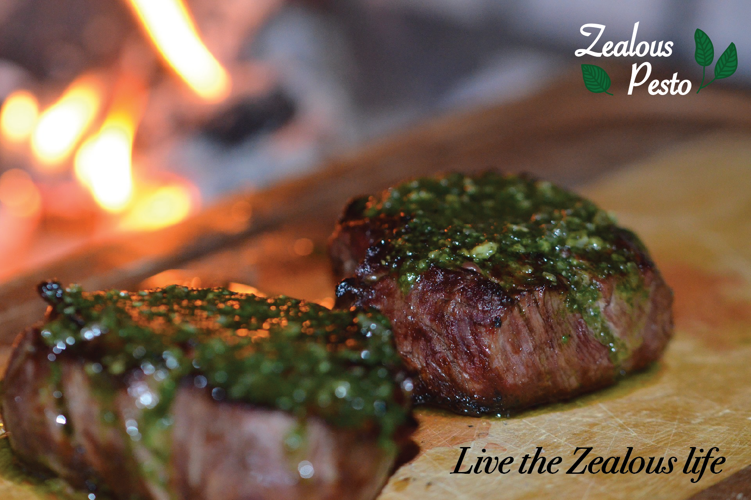
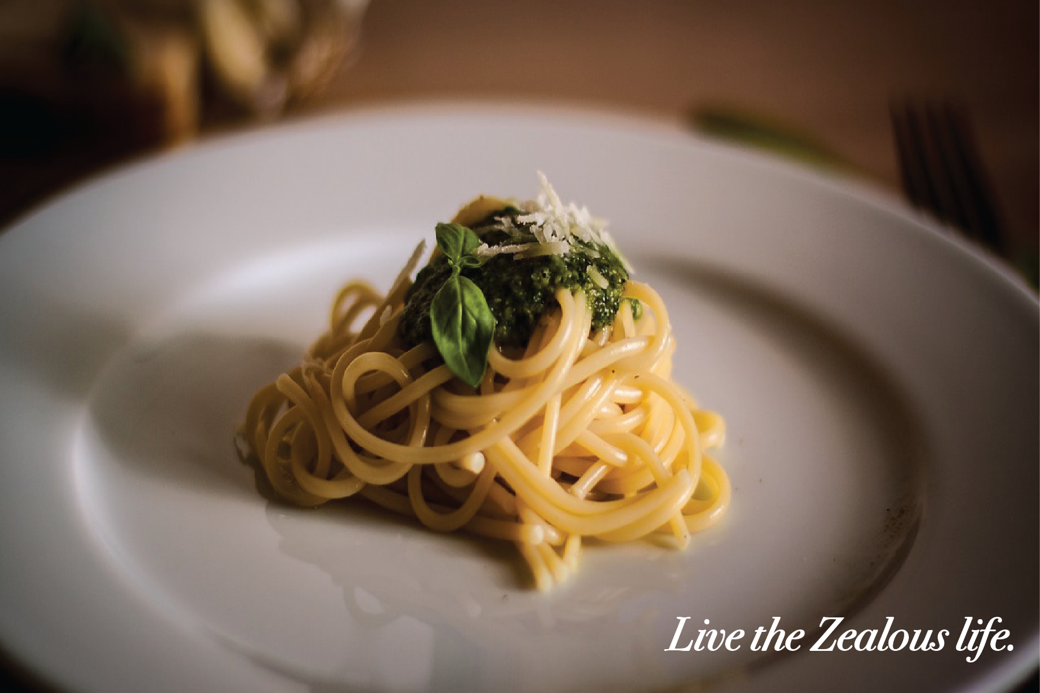
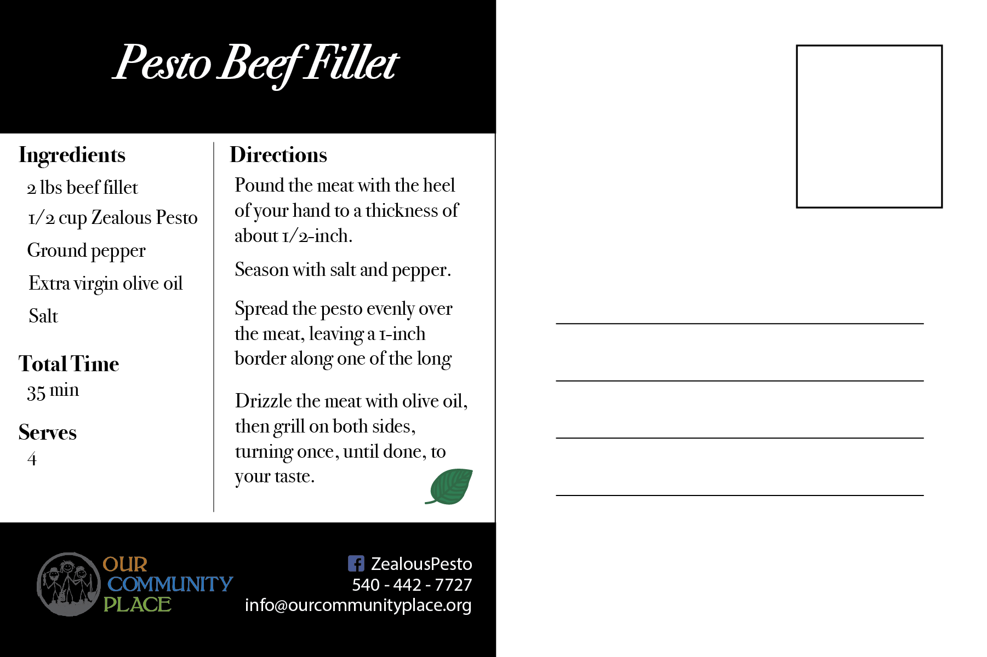
4” x 6” Recipe Postcards
c
These should serve as both a reminder and novelty advertisement that creates new ways to use Zealous for people who have or have not purchased the product.
Should be an effective conversion piece since direct mail is the most commonly-sited purchase influencer for baby boomers.
c

Slide 16
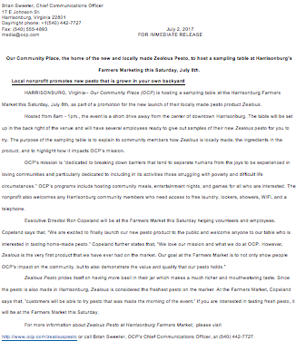
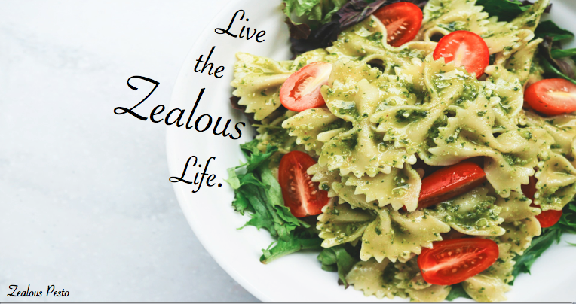
3.75” x 2.0” Size Print Ad for Bloom Magazine & Press Release
Bloom Magazine Advertisement
OCP and Farmer’s Market Press Release
We suggest a full color, print advertisement, size 3.75” x 2.0”, to be placed in Bloom Magazine each month from June to September.
Bloom Magazine is a local women’s magazine that features stories and columns by local experts on topics relevant to women.
Main objective is to create strong brand image.
Should primarily discuss the mission of OCP, the positive impact it has on the Harrisonburg community, and the Farmer’s Market event.
The press release should be sent to local journalists (DNR & WHSV).
This will be an effective awareness piece since the majority of baby boomers tend to trust PR in newspapers

Slide 17
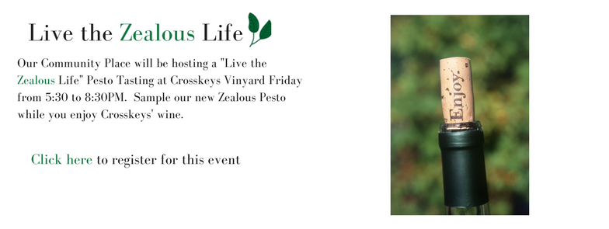
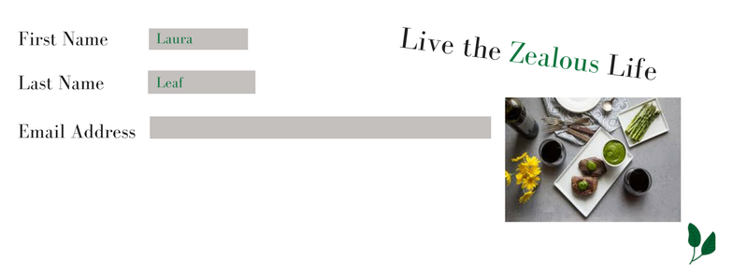
Landing Page
CrossKeys Event Landing Page
Zealous Pesto Landing Page
After hearing the call to action in OCP’s radio ad, the target should search the URL, livethezealouslife.com
The people who search this URL will be exposed to Zealous CTAs which indicates their high consideration for attending the event.
Once they type in the URL, they should then be prompted to reserve their tickets on the event landing page.
To reserve a ticket, customers should be required to enter their name and email address in order for OCP to be able to build a database.
Target market should be directed to the second landing page once they receive a confirmation email from the Crosskeys event.
This landing page should have a product description, price, and a list of the Zealous Pesto distributors.
Each list should have the phone number and address for each retailer.

Slide 18
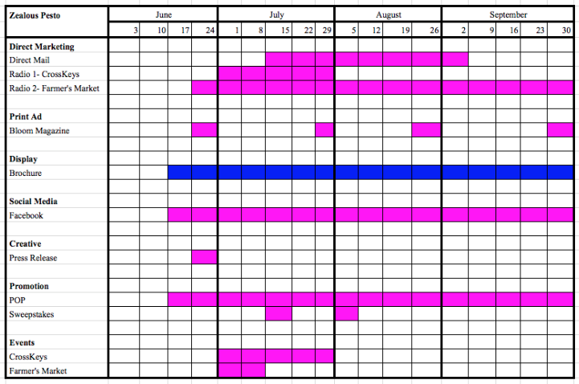
Media Plan Timeline
Blue: B&B Bob
Pink: Local Laura

Slide 19
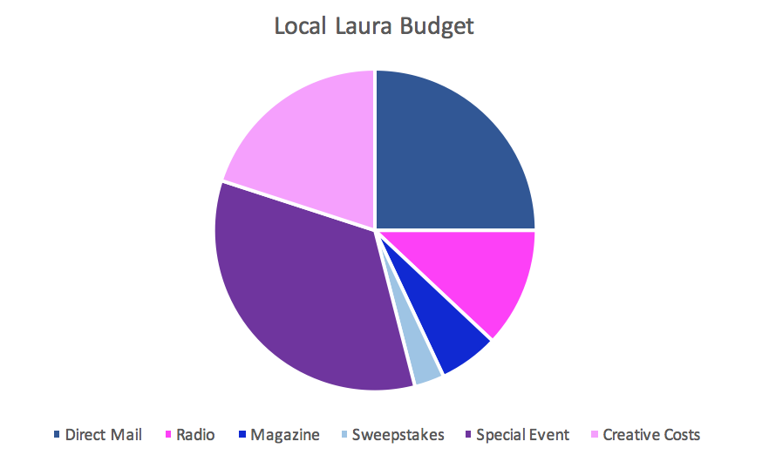
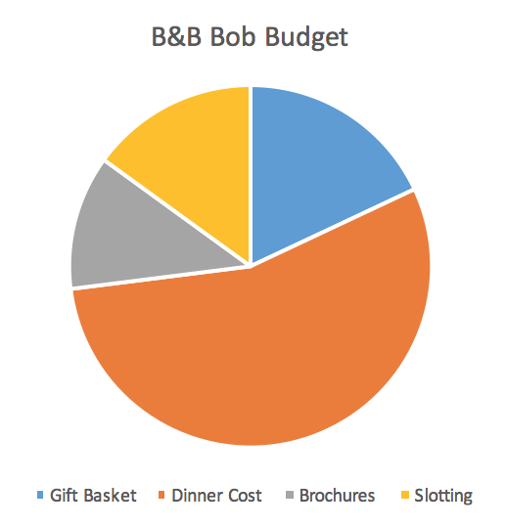
Budgeting for Laura and Bob
c
25% | 12% | 6% | 3% | 34% | 20%
18% | 55% | 12% | 15%
Notes:
Local Laura: Direct Mail 25%, Radio 12%, Magazine 6%, sweepstakes 3%, Special event 34%, creative costs 20%
B&B Bob: gift basket 18%, dinner cost 55%, brochures 12%, slotting 15%

Slide 20
The Zealous Life is Waiting ...
Notes:
Join us, the zealous life is waiting (awaits)

